Slide 1


Unbreakable CI/CD Pipeline in Microsoft Azure
Safia Habib, Dynatrace @Safia_az
Followed by live Q&A:
Part of: http://bit.ly/onlineperfclinic
Get Dynatrace SaaS Trial: http://bit.ly/dtsaastrial
Listen to PurePerformance: http://bit.ly/pureperf
Andreas Grabner @grabnerandi

Slide 2
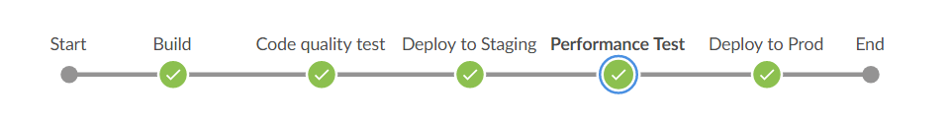
Microsoft Azure
Dynatrace Tenant
Azure Devops
Pipeline View

Slide 3
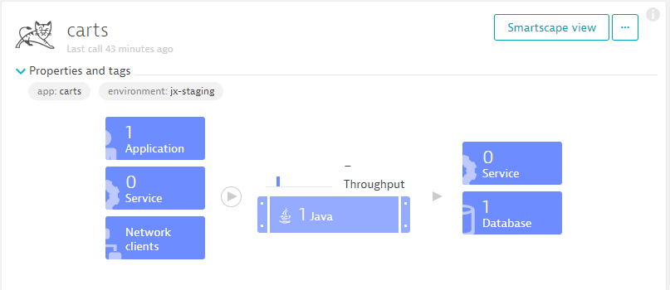

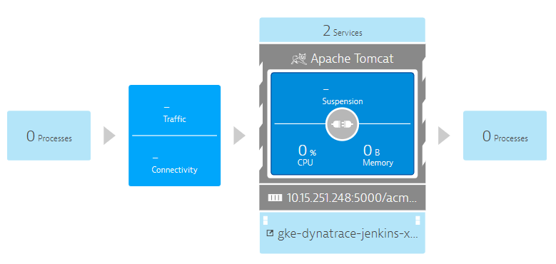
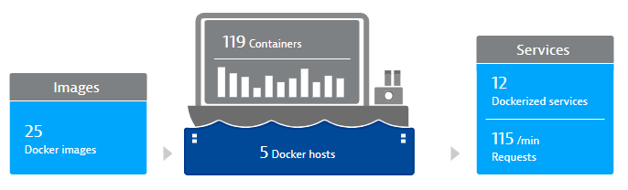
Microsoft Azure
Dynatrace Tenant
Monitoring Data
(1) Full Stack Monitoring Data in Dynatrace
(1) Automatic Monitoring
(1) Deploy OneAgent
Azure Devops
Pipeline View
(1)

Slide 4

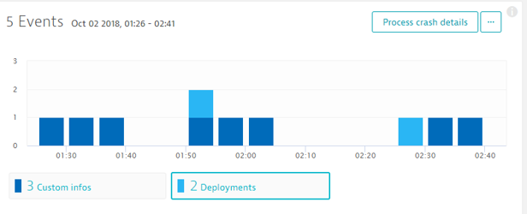
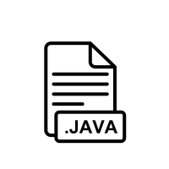

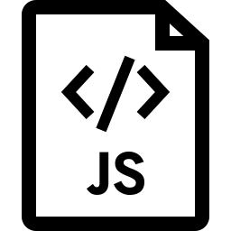
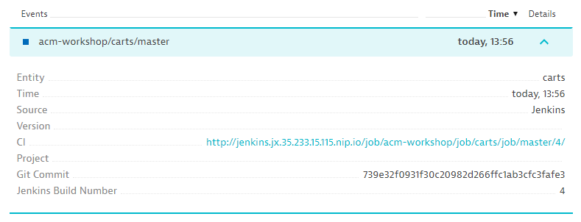
Microsoft Azure
Dynatrace Tenant
Monitoring Data
(2) Service Monitoring & Event Insights
(2) push deploy events
(2) Build & deploy to environment
Azure Devops
Pipeline View
(2)
(2)

Slide 5
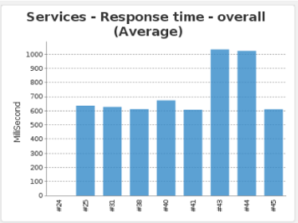
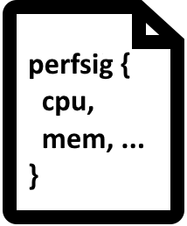
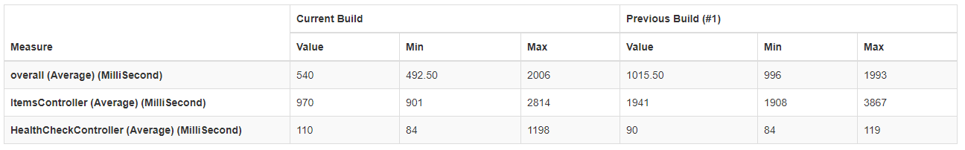
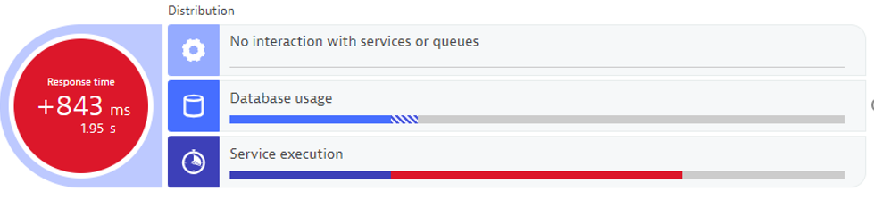
Microsoft Azure
Dynatrace Tenant
Monitoring Data
(4) Quality Gate Metrics Build over Build
(4) Pull Performance Signature Metrics & Push Validation Event
Azure Devops
Automatic Comparison between Builds
Pipeline View
(4)

Slide 6
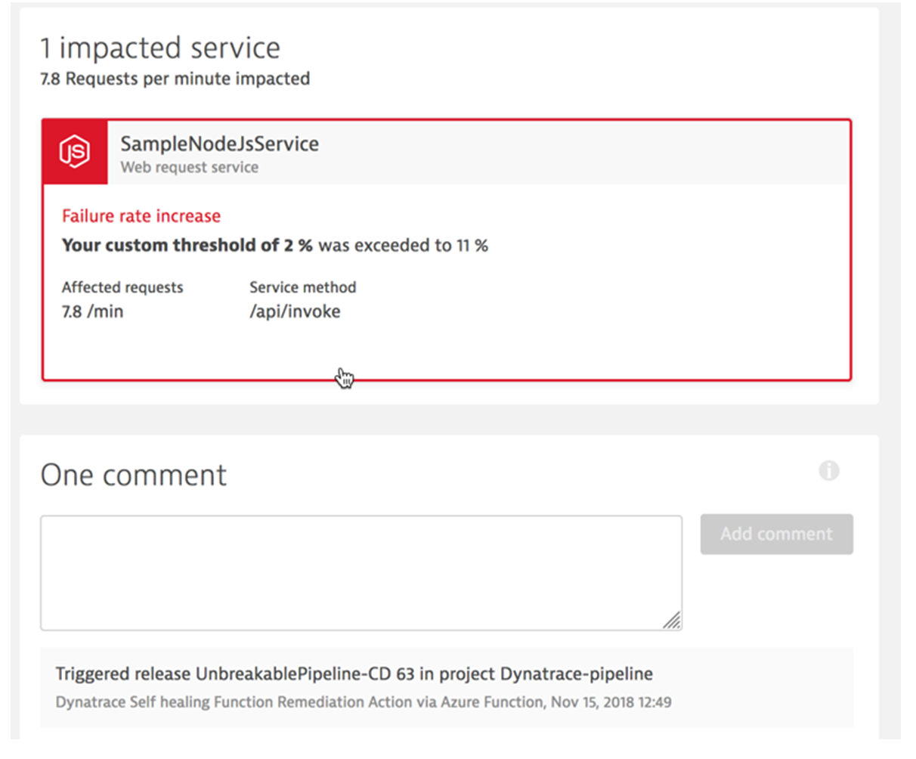
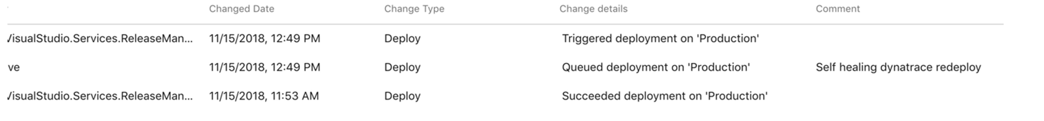
Microsoft Azure
Dynatrace Tenant
Monitoring Data
(5) Self Healing Revert back build
(5)- Problem Event
(5)- Deploy Previous good Build
Redeploy good Build into Prod
Azure Devops
Pipeline View
Self Healing

Slide 7
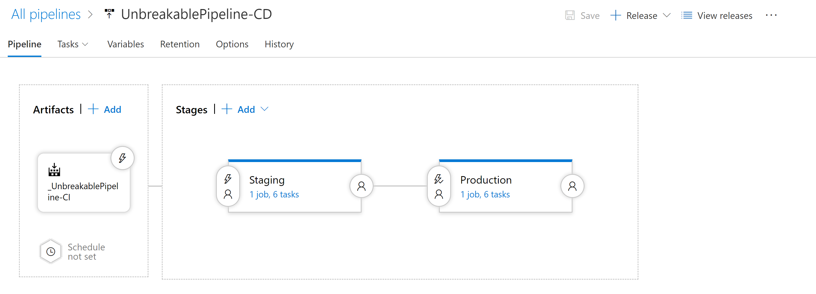
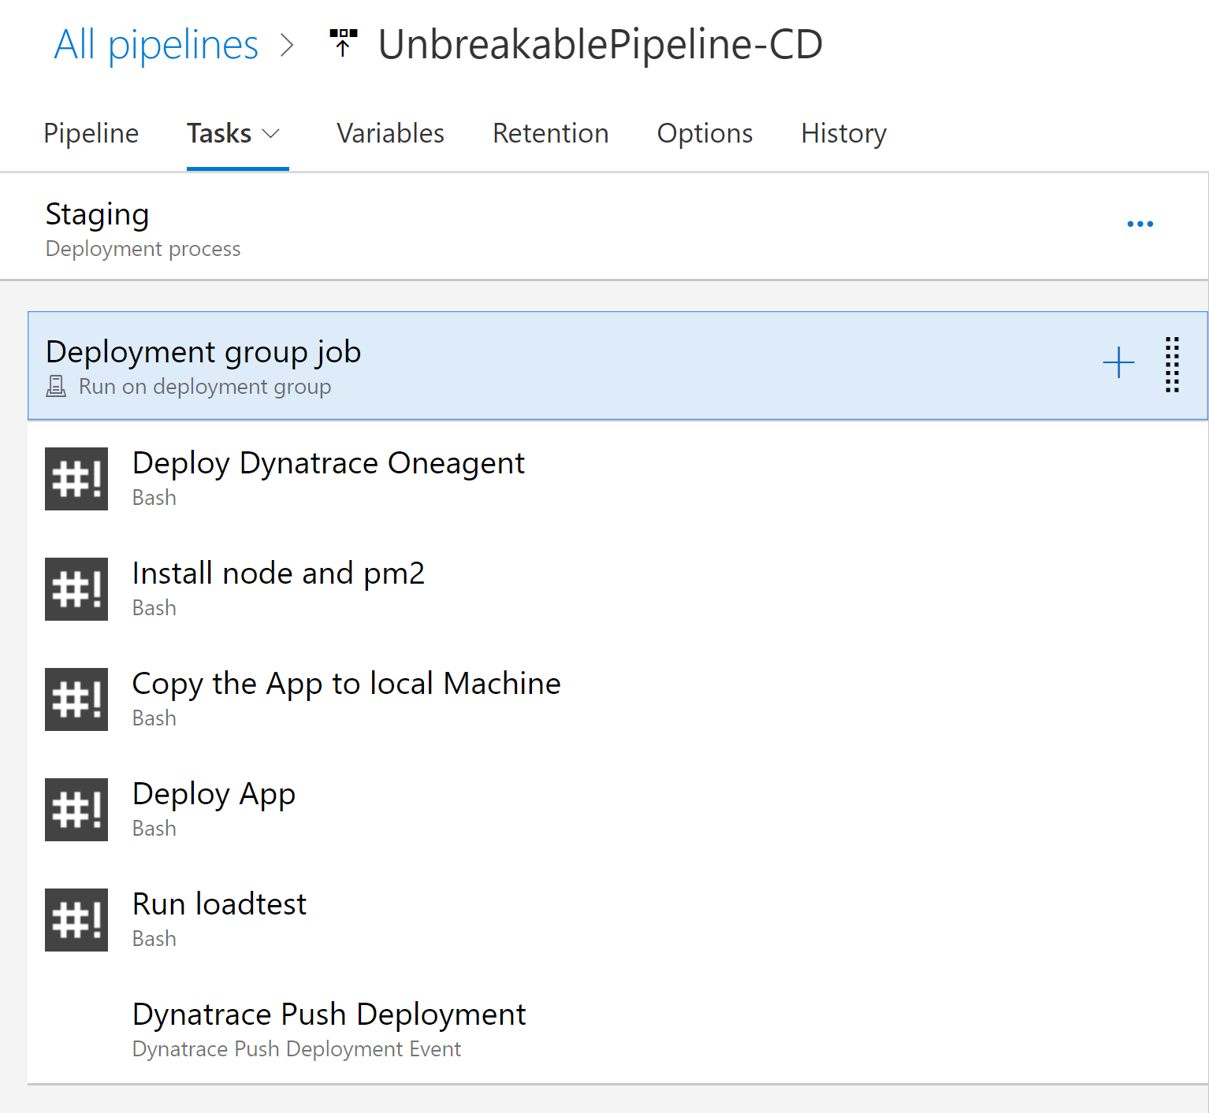
The Pipeline
Push Deployment to Dynatrace

Slide 8
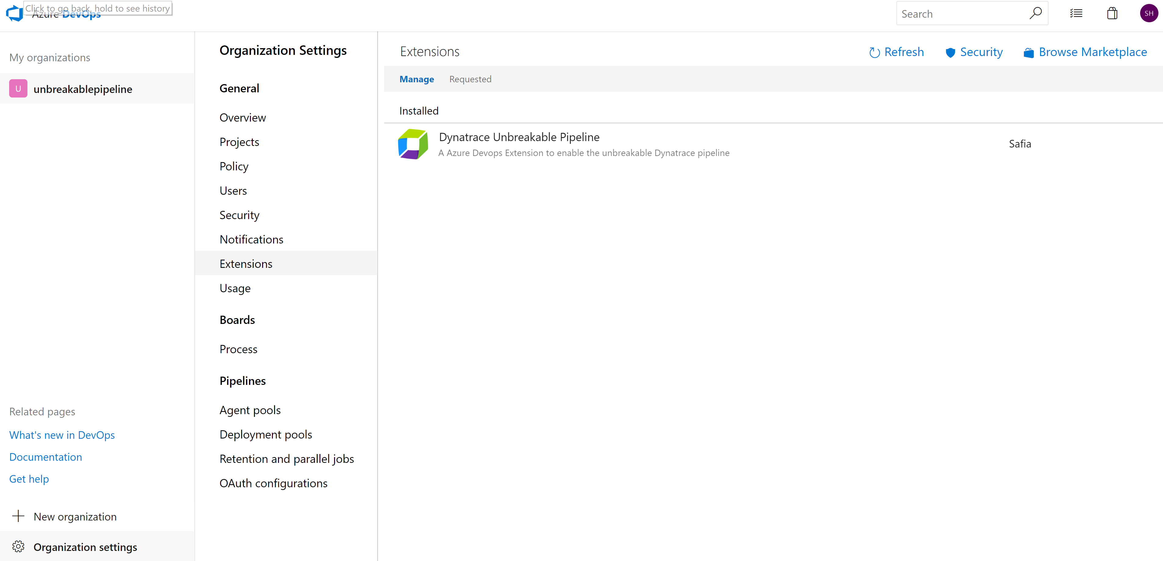
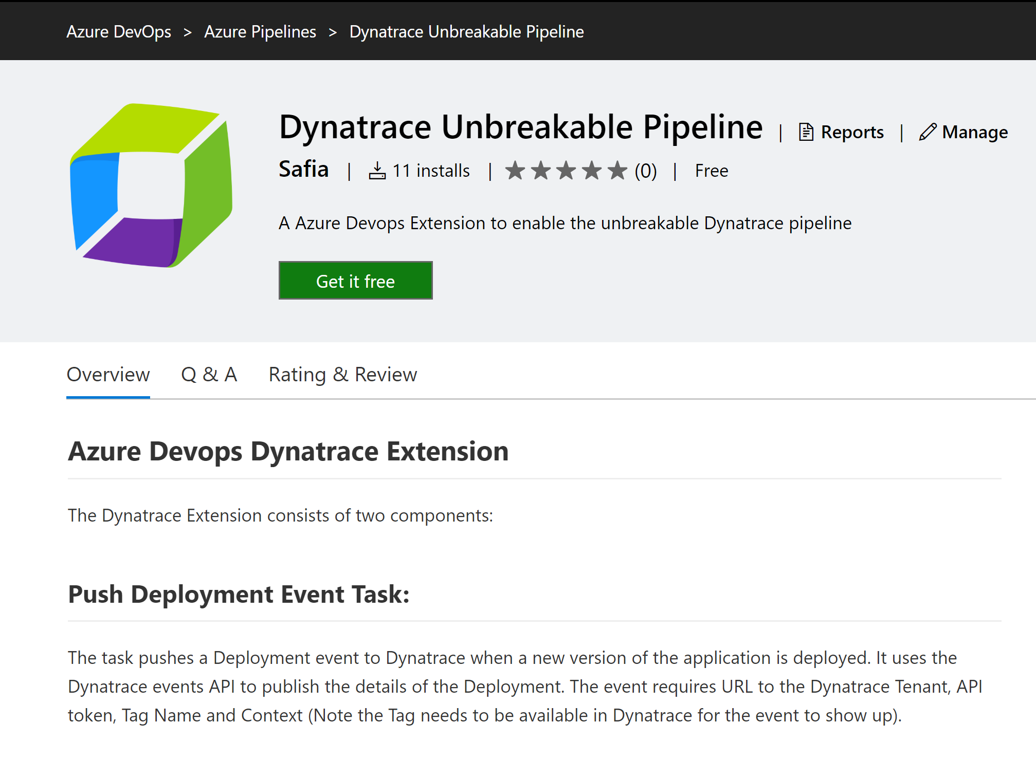
Getting Started – Get the Dynatrace Extension

Slide 9
What does the Extension Give
#1 Task
Push Deployment Event to Dynatrace
#2 Release gate
Quality Gate to pull Performance Signature and validate the build

Slide 10
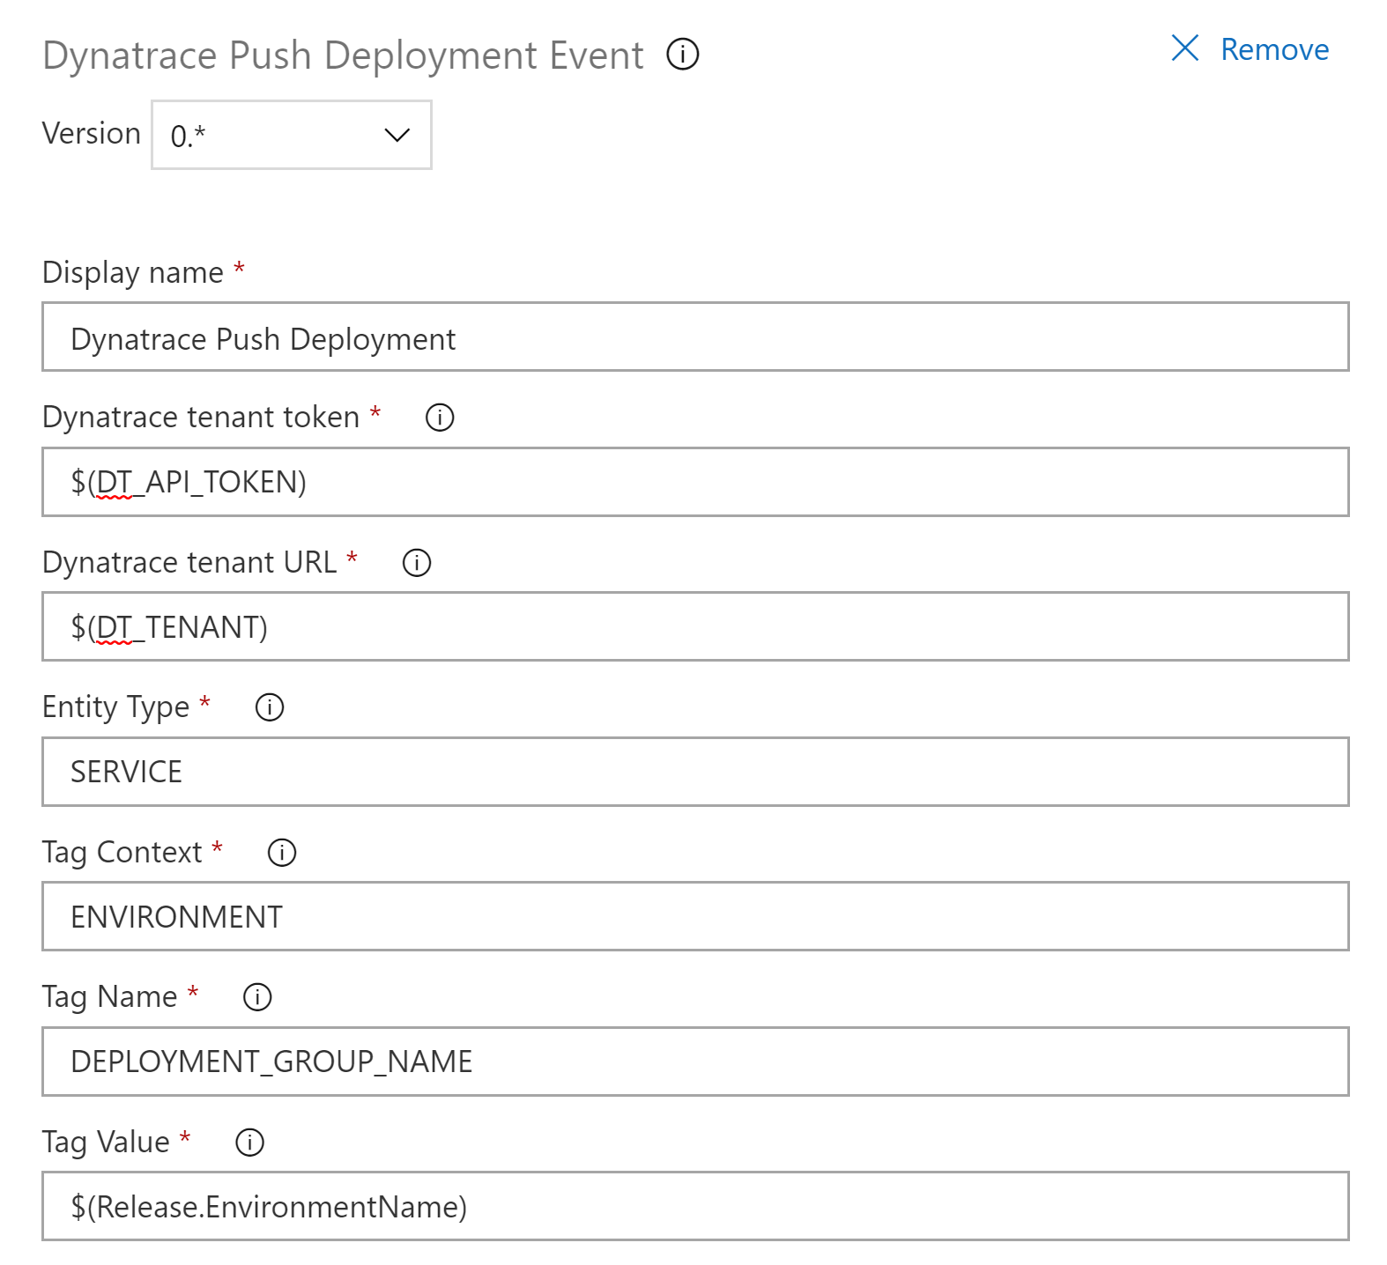
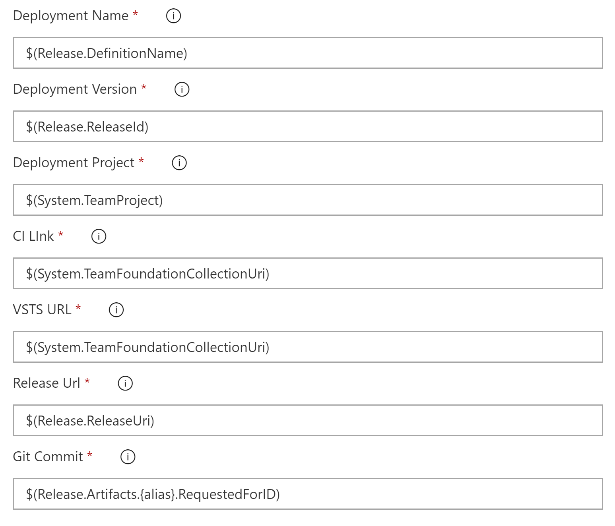
#1 Task – Push Deployment Event to Dynatrace
Provide additional information – CI Link, Project Name, etc
Define Entity Type and Tags (Environment)

Slide 11
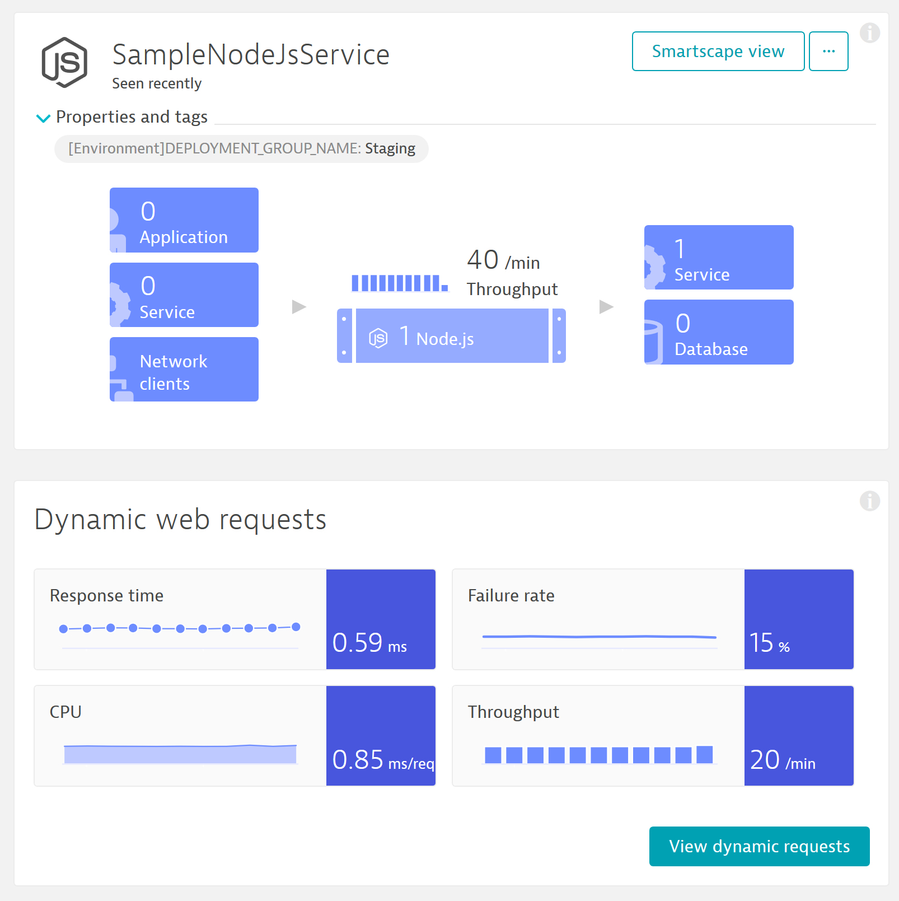
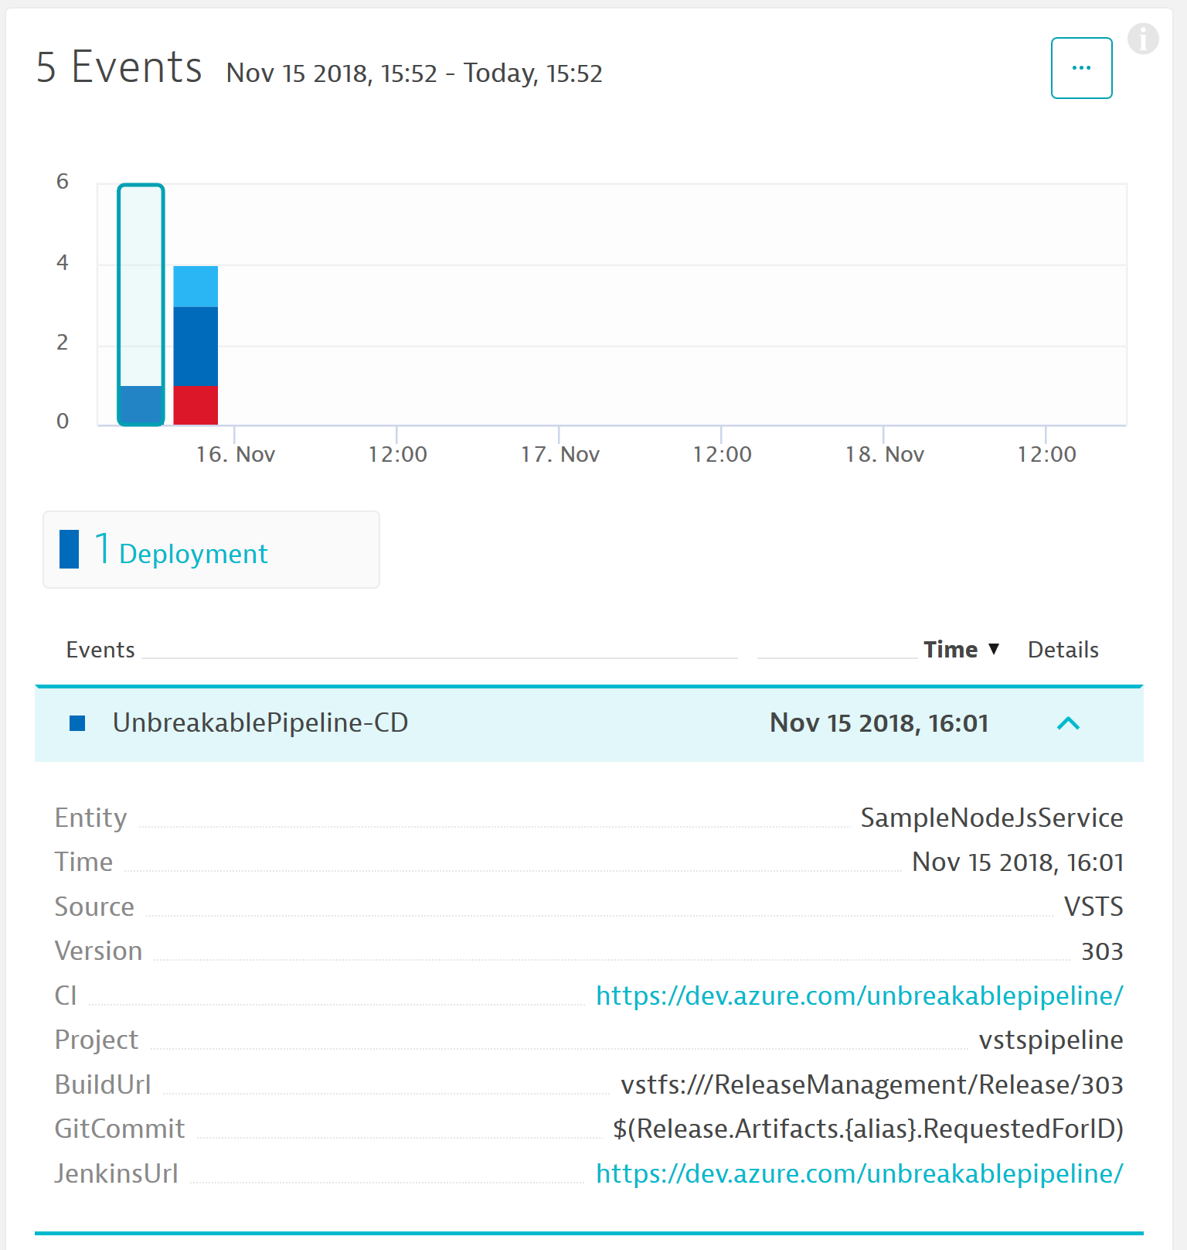
#1 Push Deployment Result
Service With the Tag
Deployment Event From the Pipeline

Slide 12
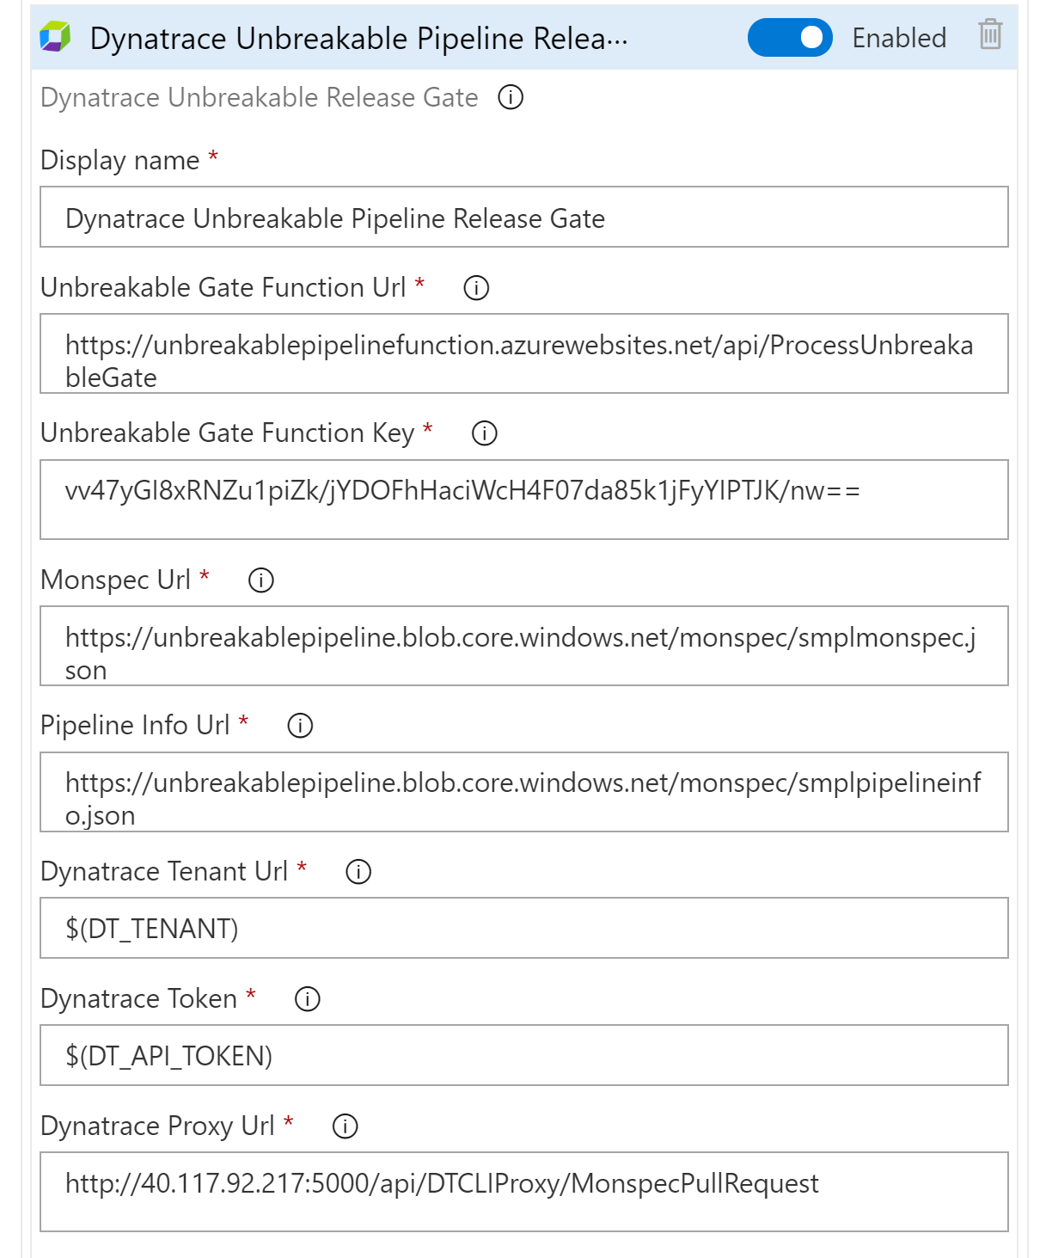
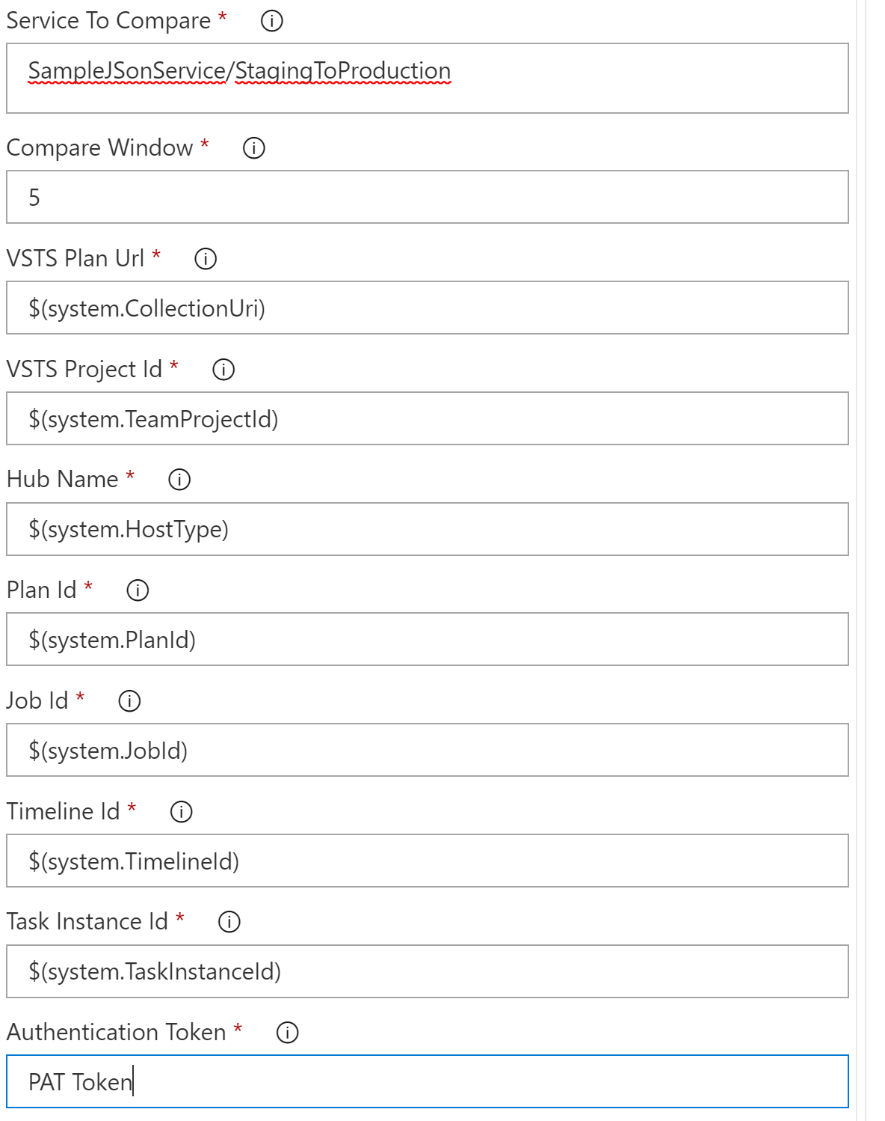
#2 Release Gate – For validation and quality
Compare Parameters
Configuration

Slide 13
Behind the scenes: Approval Stage Automate metrics Comparison to validate build

Slide 14
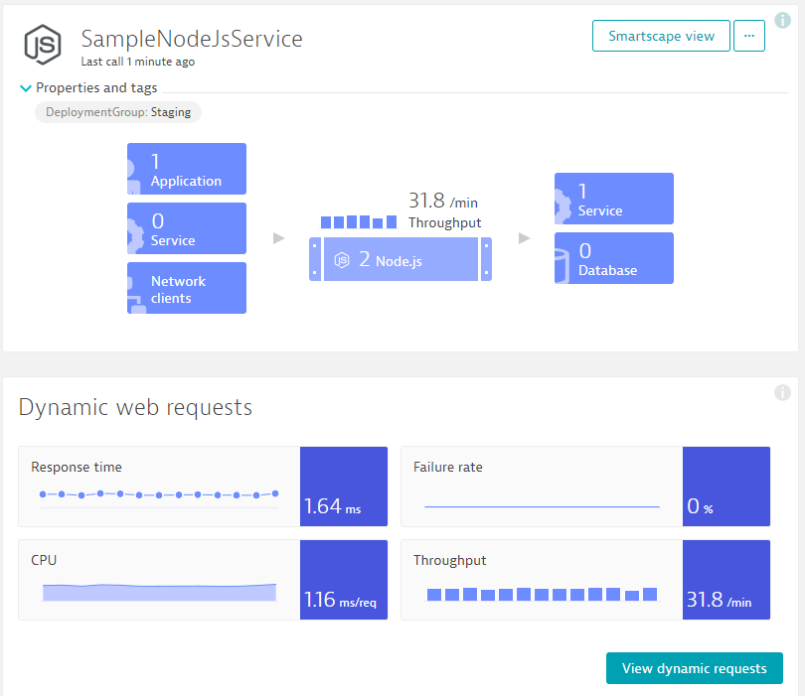
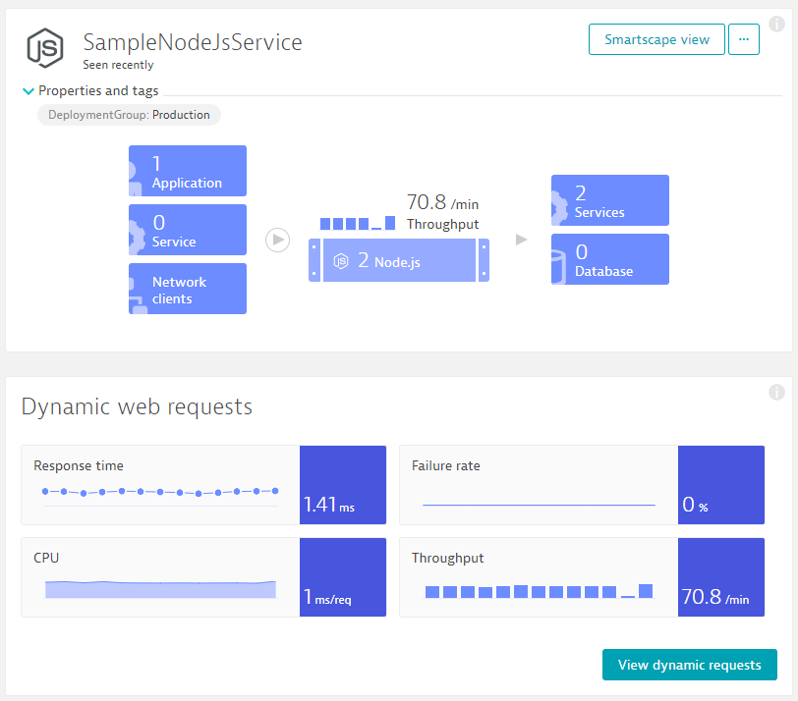
Monitoring as Code: Compare Metrics of Services of Different Environments/Builds
Entity: SampleJSonService
Different Metrics
Environment: Staging
Tag: DeploymentGroup:Staging
Environment: Production
Tag: DeploymentGroup:Production
Metrics: ResponseTime (Avg)
Metrics: ResponseTime(Max) < 10s
Metrics: FailureRate(Avg)
Metrics: ResponseCount
Factor: 90% Less vs Production
Different Comparisons
Compare: StagingToProduction
Source: Staging; Compare: Prod
Factor: Staging = 10% Slower
Compare: StagingToProdYesterday
Source: Staging; Compare: Prod
Factor: 10%, Timeshift: 86400s
Compare: StagingToStagingLastHour
Source: Staging; Compare: Staging
Factor: 0; Timeshift: 3600s
Compare: StageToStageYesterday
Source: Staging; Compare: Staging
Factor: 0; Timeshift: 86400s
Pipeline Run: Validate Build with StagingToProduction
Source (Staging): 1.64ms
Environment: Staging
Environment: Production
Compare (Production): 1.41ms
Threshold (+10%): 1.56ms
Status: VIOLATION

Slide 15
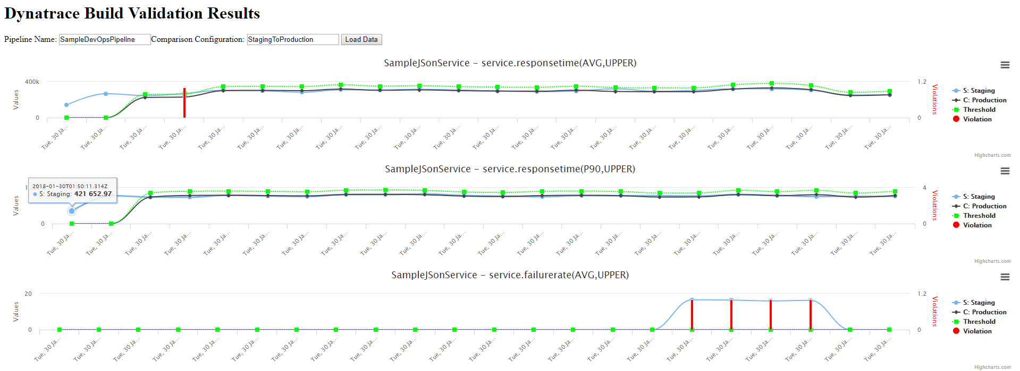
Automate the Comparison: Trigger it for each Build and keep track of status!
Comparisons
Entity
Metrics
Environment
Good Build
Good Build
Good Build
Bad Build
Bad Build
Bad Build
Good Build
Bad Build

Slide 16
DEMO TIME

Slide 17
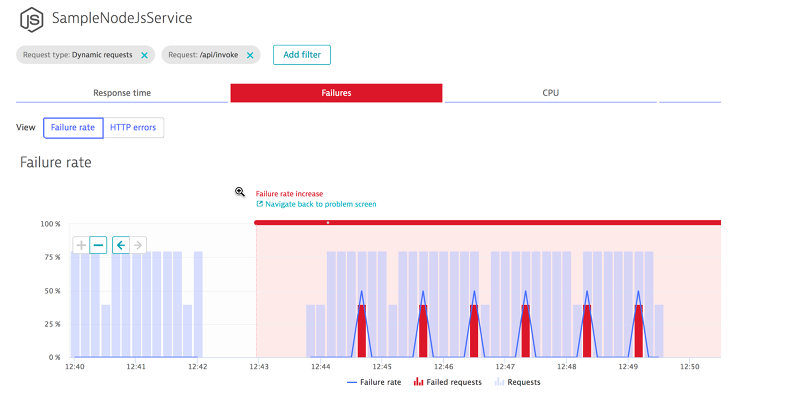
Self Healing in action
Problem Created in Dynatrace

Slide 18
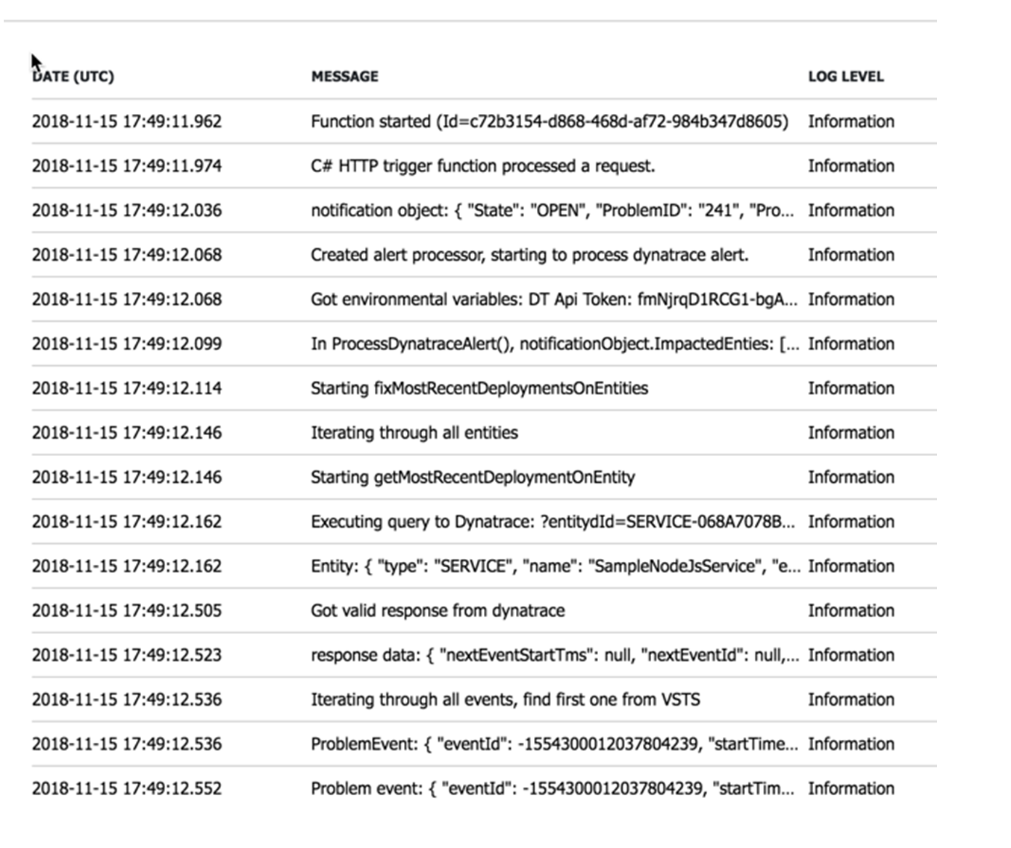
Self Healing in action
Self Healing Function in action

Slide 19
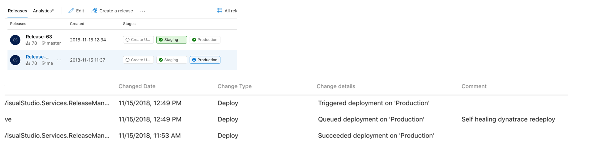
Self Healing in action
Redeploy to Production Triggered in Devops

Slide 20
Additional Resources & Reminders
Get your Dynatrace SaaS or Managed Trial: http://bit.ly/dtsaastrial
Meetups and User Groups: We are happy to present!
PERFORM Events: https://perform.dynatrace.com
Upcoming Performance Clinics & other webinars: https://www.dynatrace.com/news/webinar/upcoming
More events: https://www.dynatrace.com/company/events/
More user groups: https://community.dynatrace.com/community/display/PUBEVENTS/Events
Online Training Material
Dynatrace University: http://university.dynatrace.com
Dynatrace FullStack YouTube Playlist: http://bit.ly/oneagenttutorials
Dynatrace Coffee Breaks: http://dynatrace.ai/coffeebreak
Dynatrace Power Demos: https://www.dynatrace.com/demos/
PurePerformance Podcast: http://bit.ly/pureperf

Slide 21


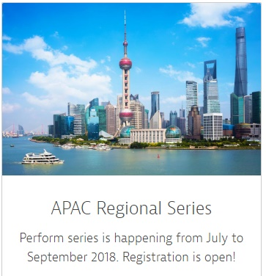
https://perform.dynatrace.com

